Slide 1


Slide 2

Notes:
Analysis

Slide 3
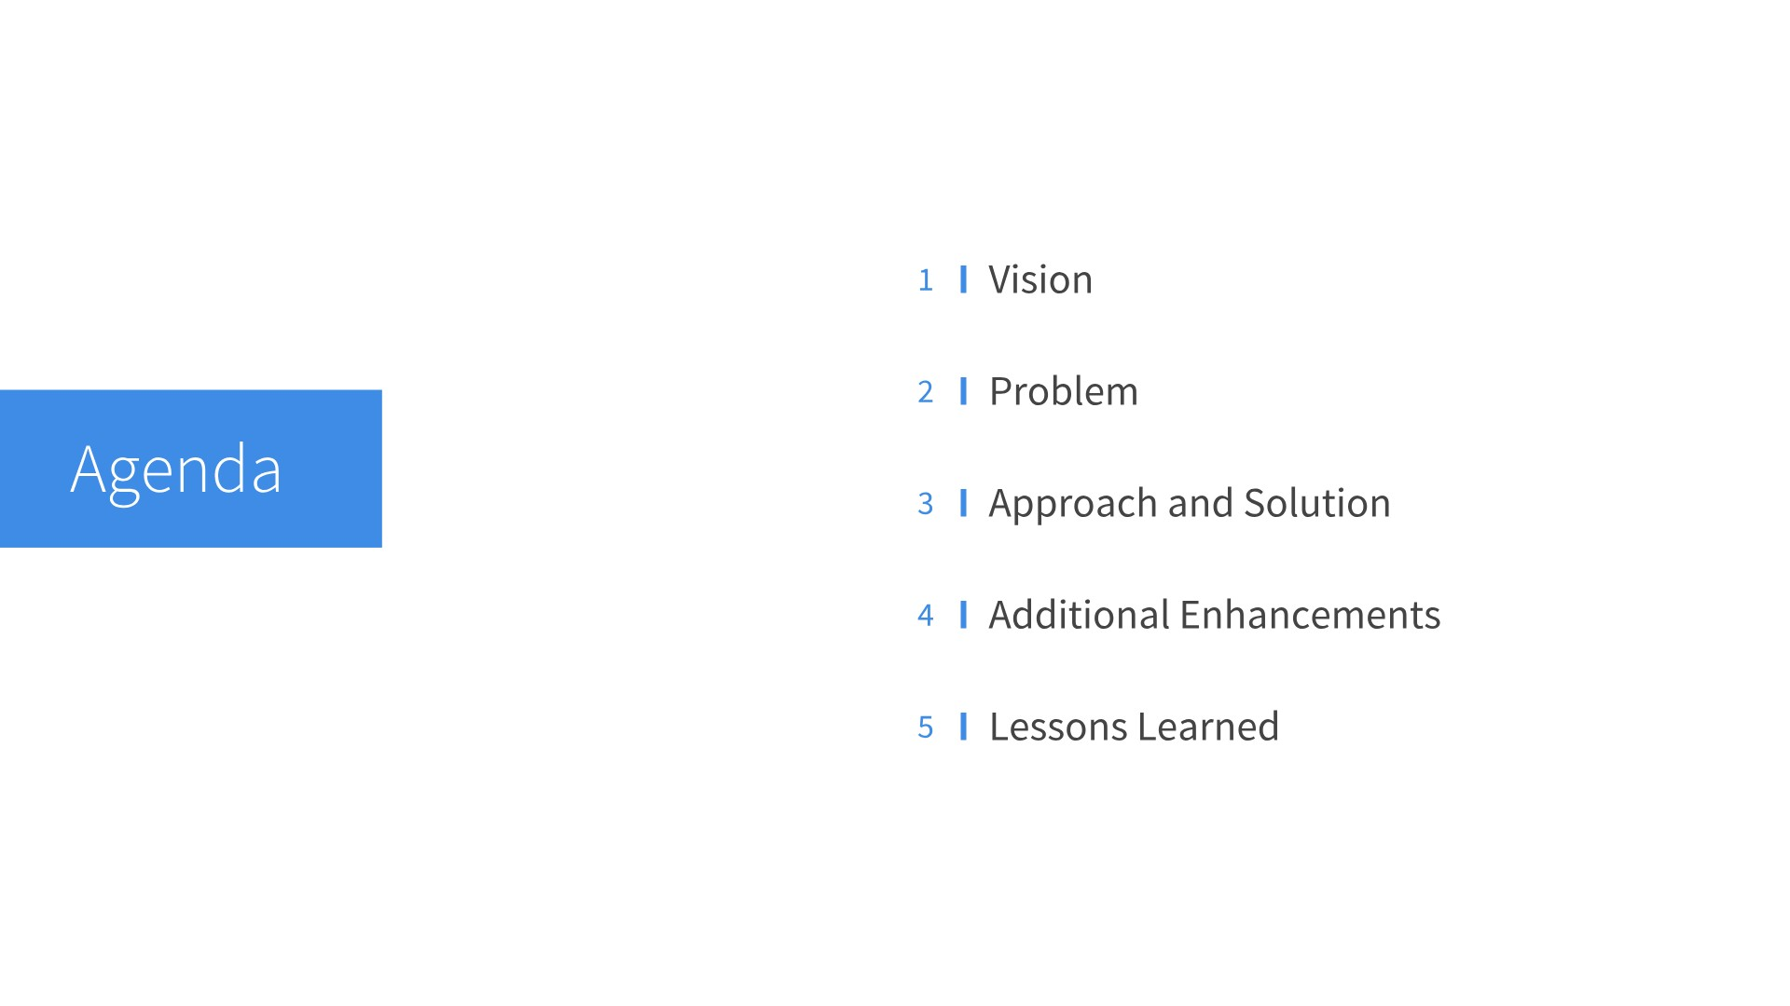

Slide 4


Slide 5
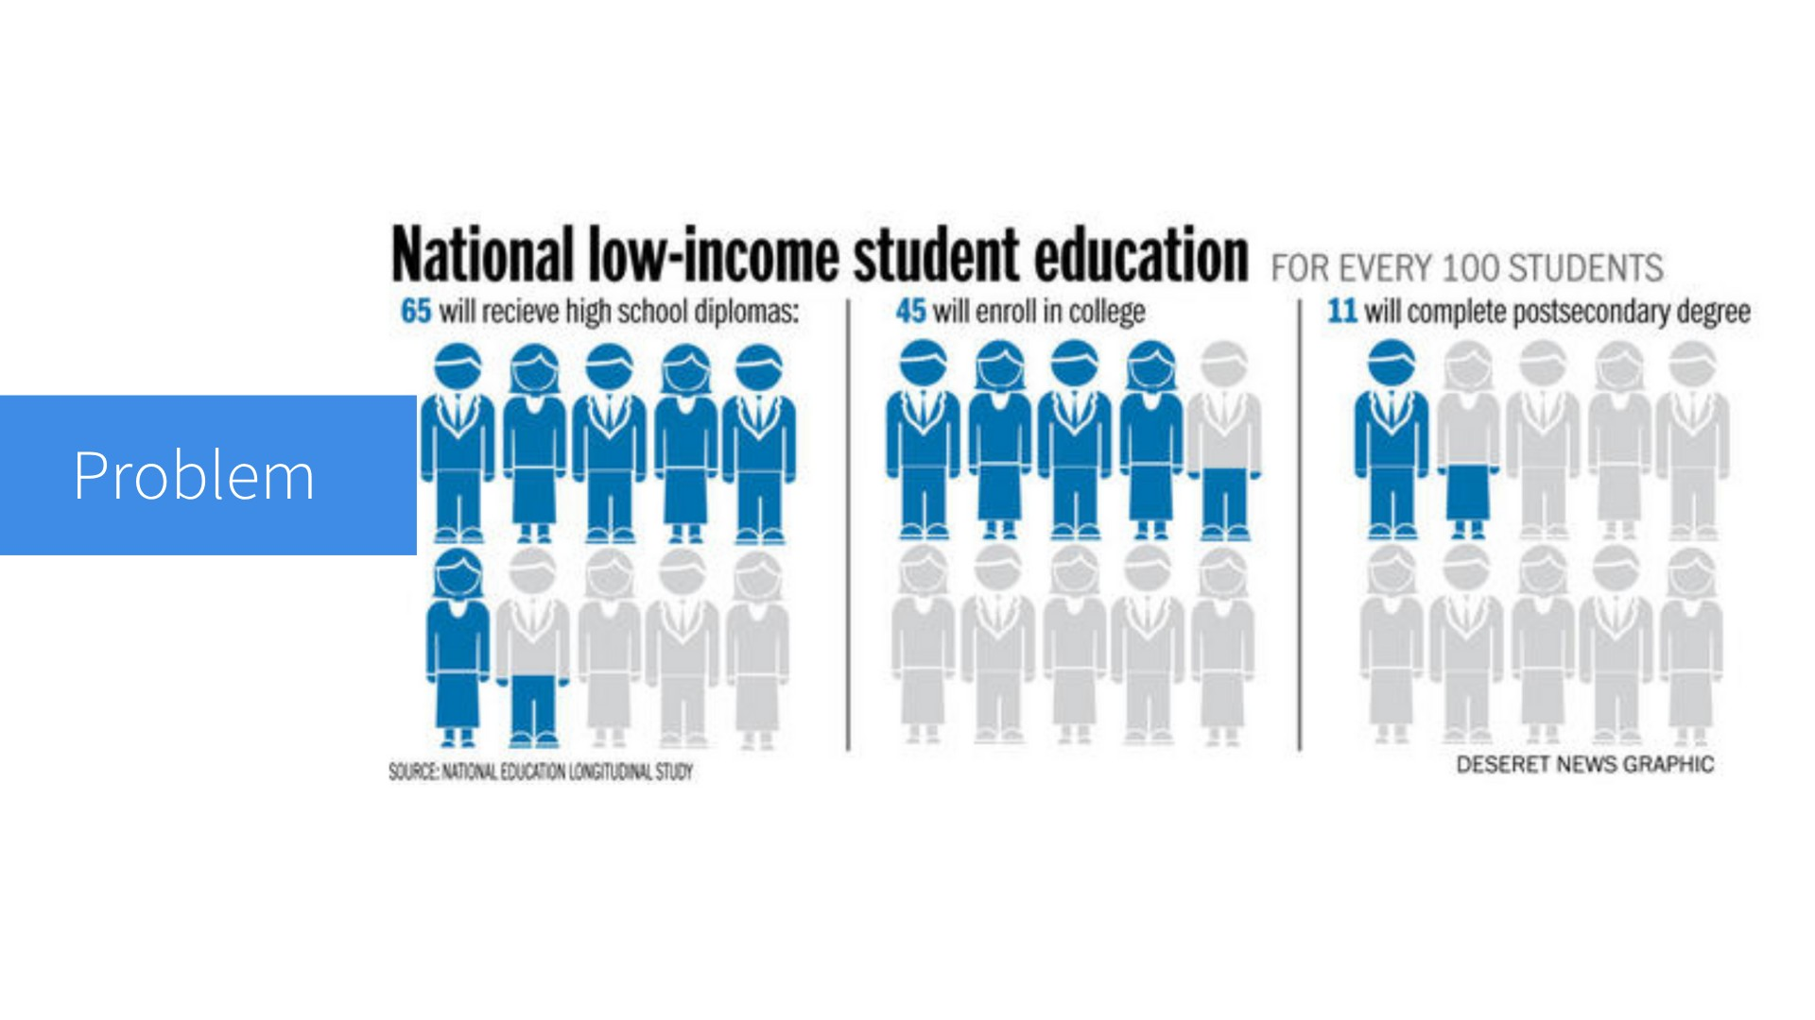

Slide 6
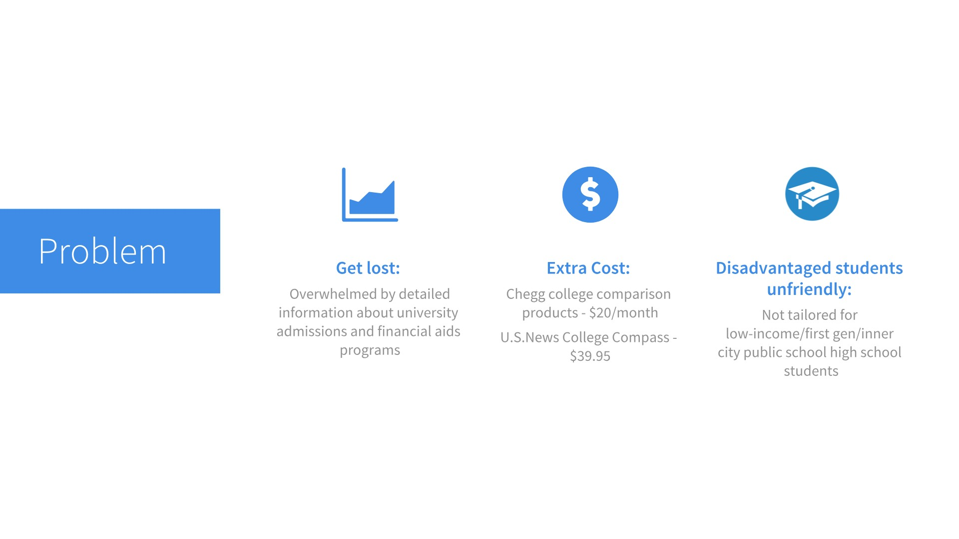
Notes:
It's very easy for students to get overwhelmed by tons of information from the Internet. If you want access to some well-organized data, you have to pay for it.

Slide 7
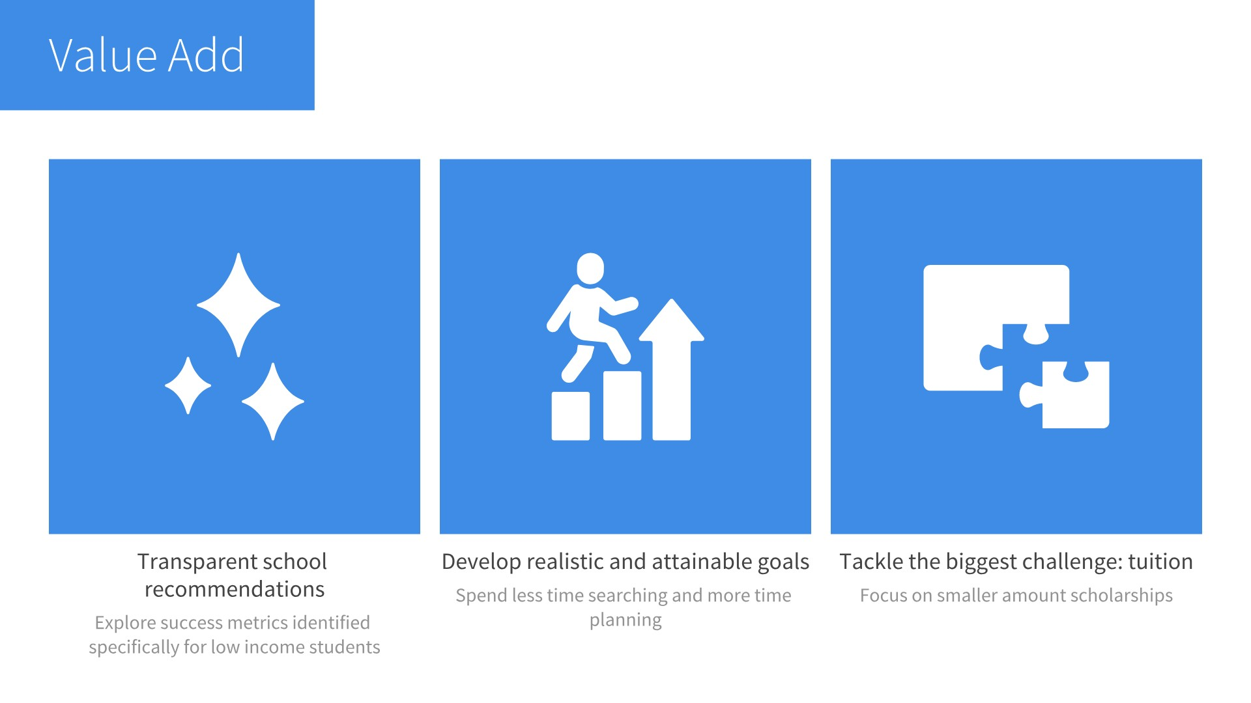

Slide 8
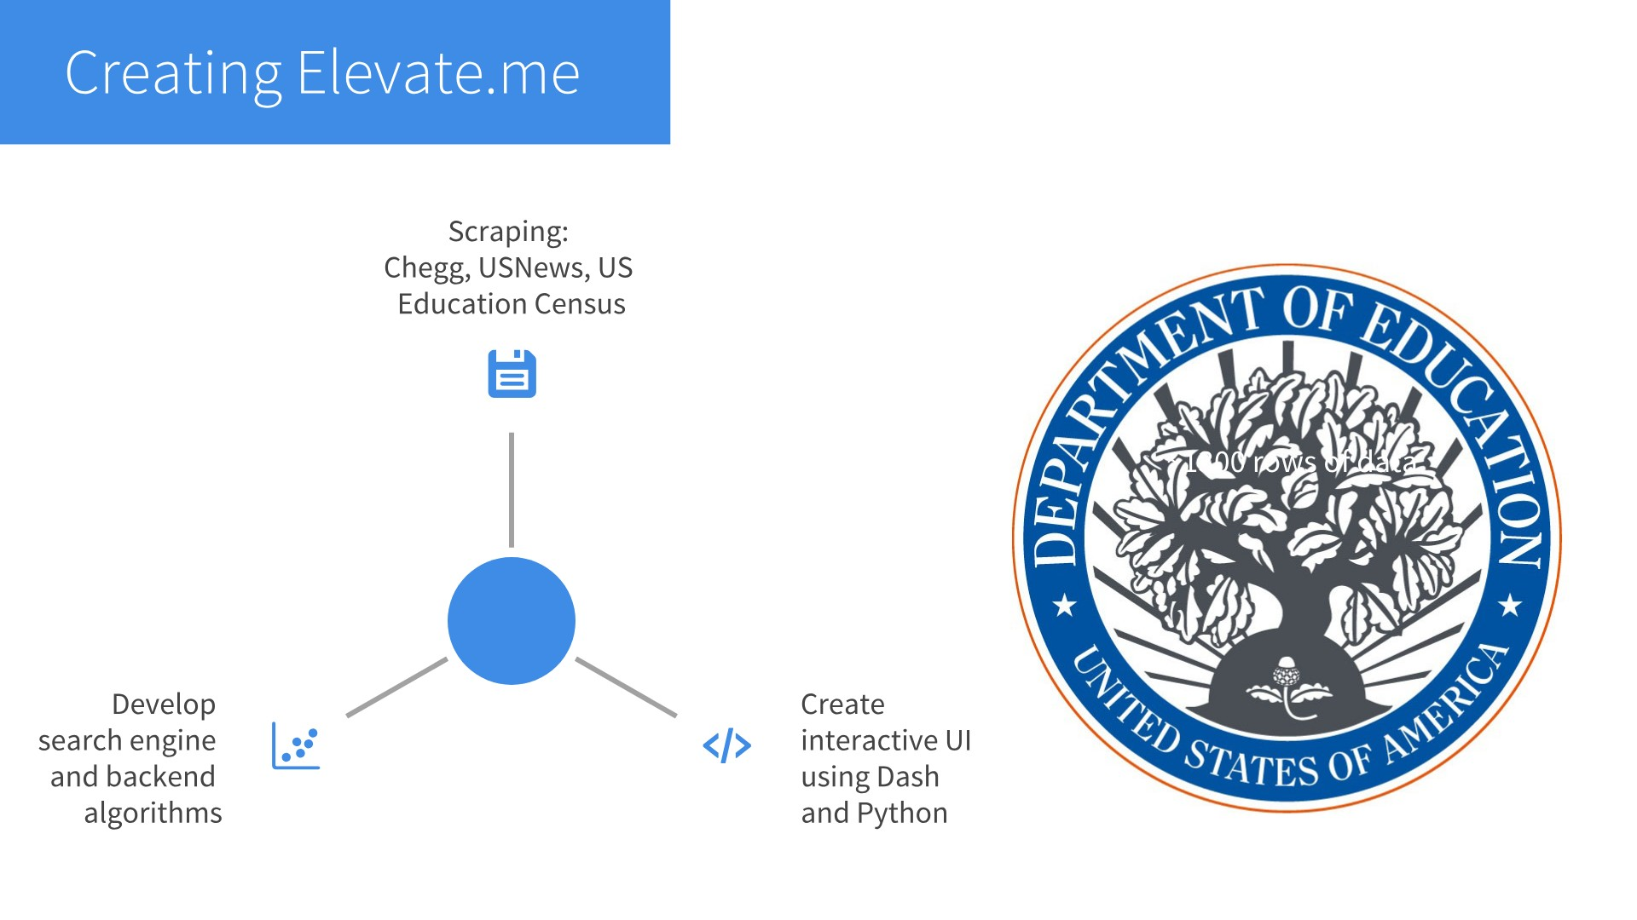

Slide 9
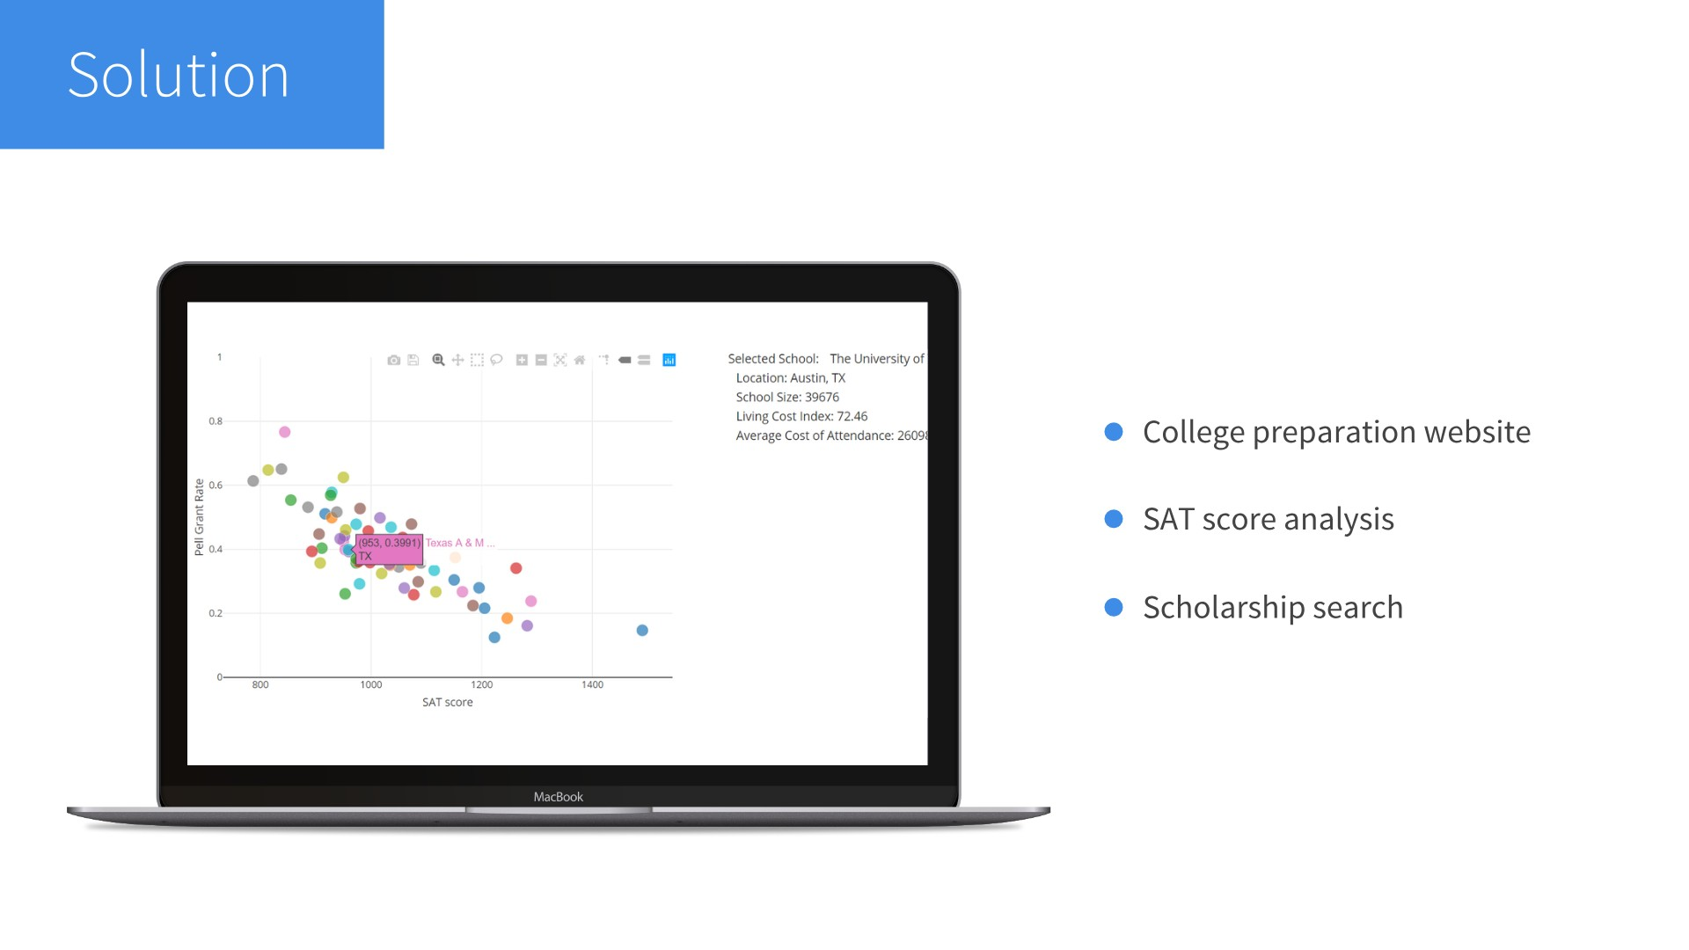

Slide 10
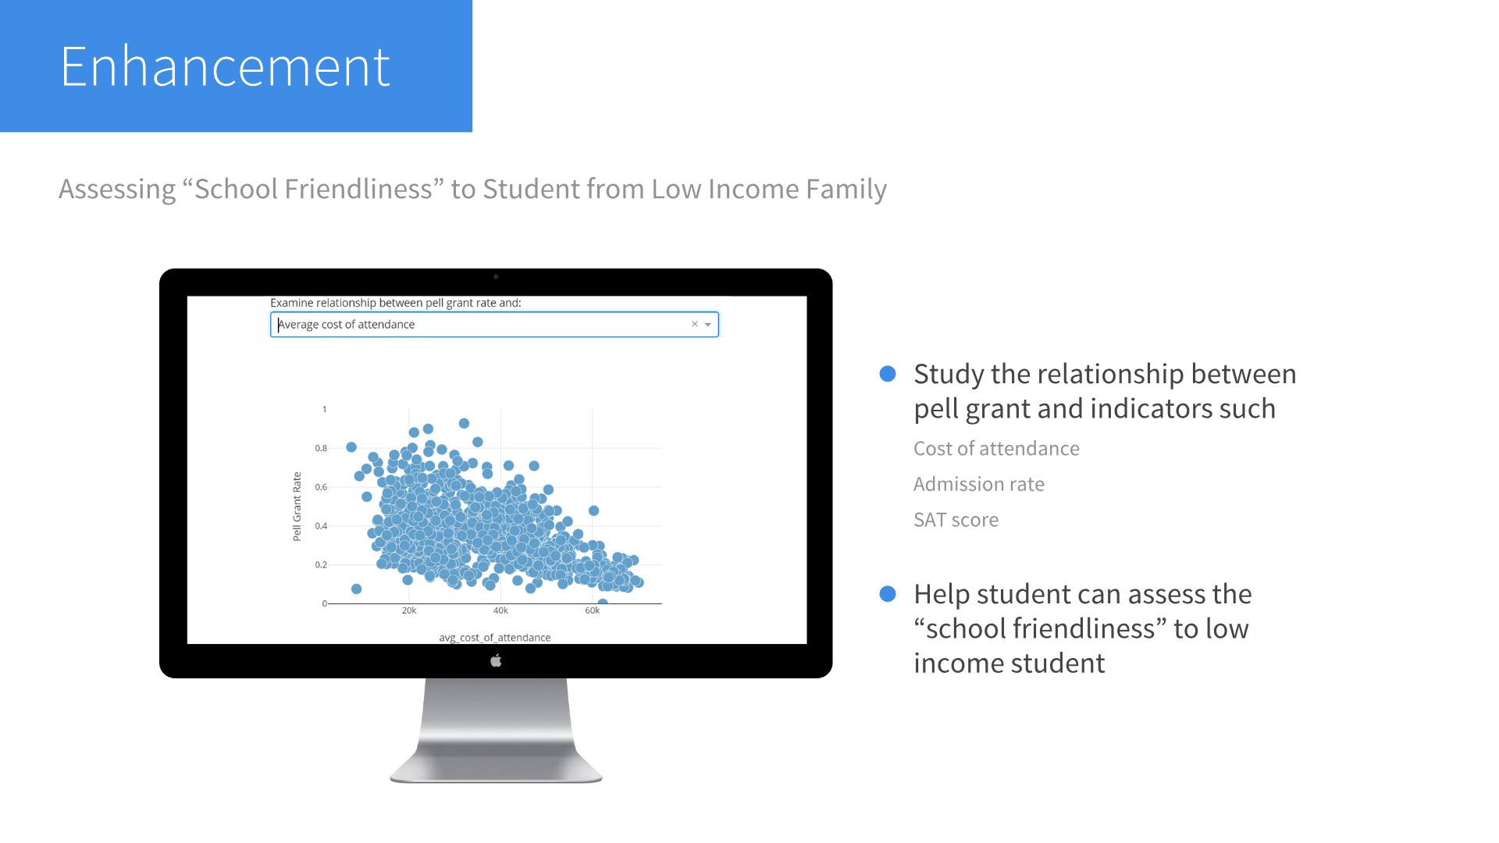

Slide 11
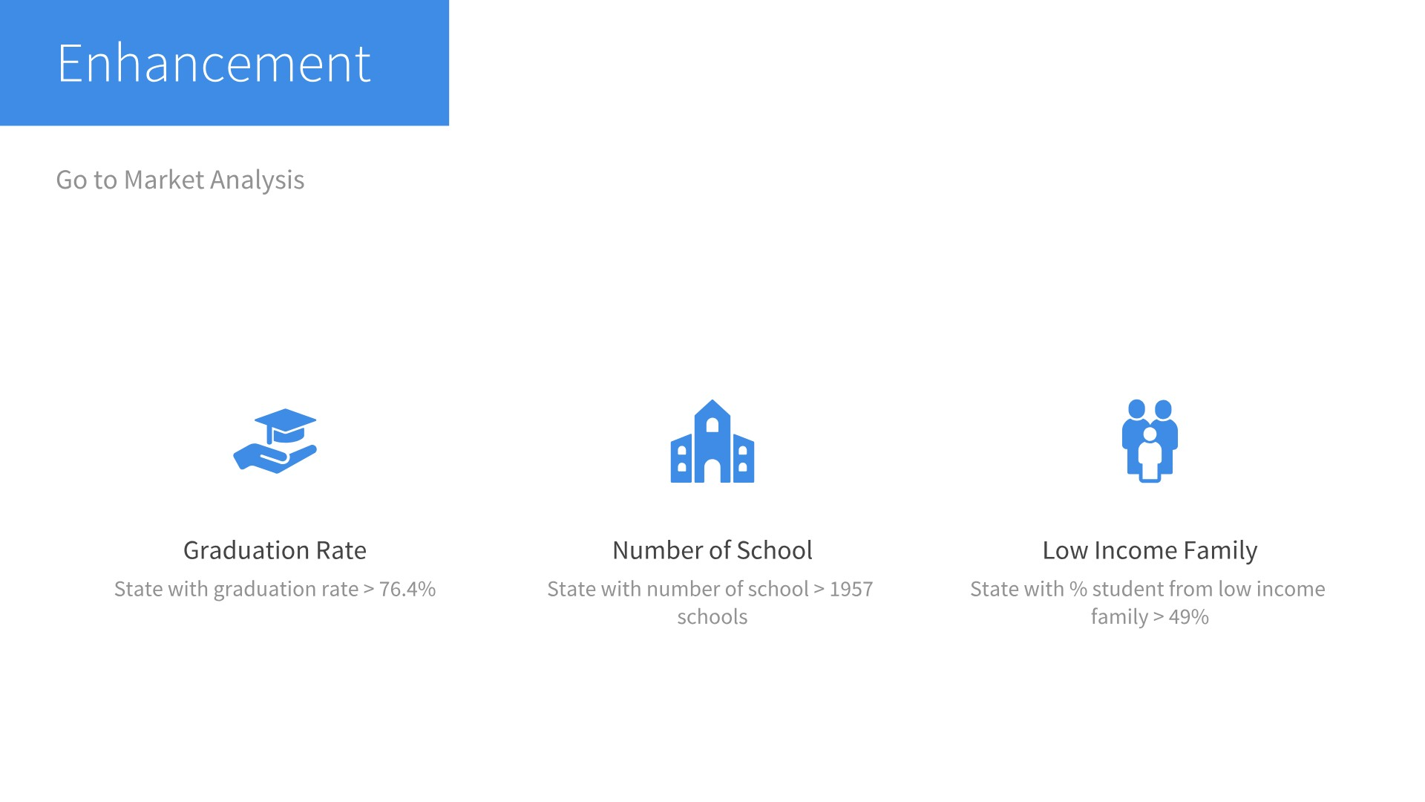

Slide 12
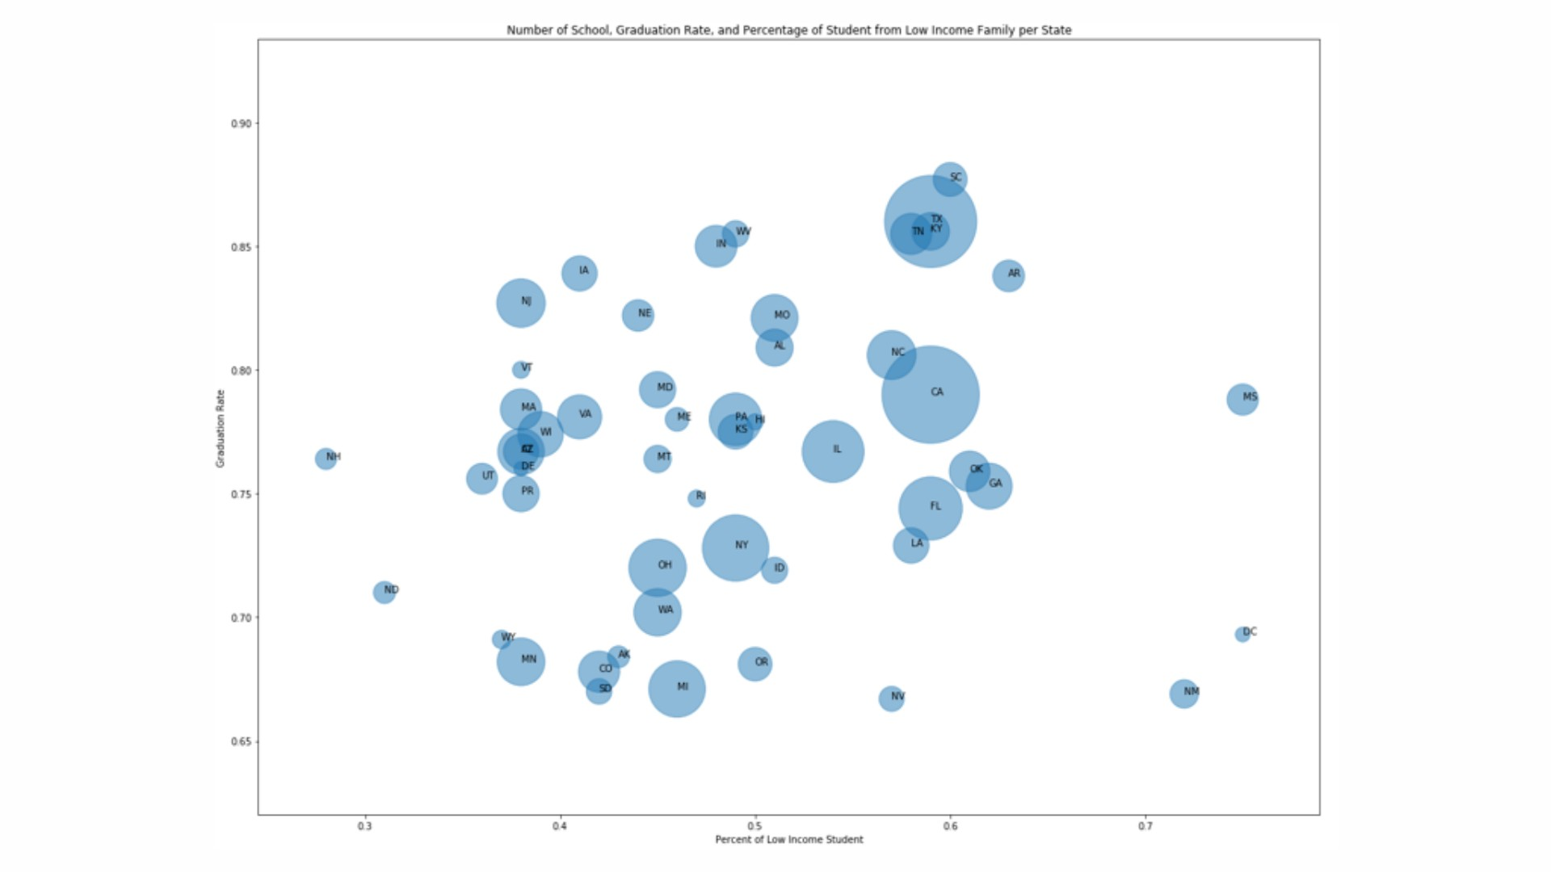

Slide 13
